Slide 1
W05D5
Midterm Project Kickoff
Instructor: Jeremy Eng

Slide 2
Outline for today
Project descriptions
Predicting flight delays
Clustering NYC neighborhoods
Project skeleton
How to plan the project
How to divide tasks
GitHub essentials
Evaluation criteria

Slide 3
Project descriptions

Slide 4
Predicting flight delays
Supervised Learning:
Regression Problem: Predict delay of flights 1 week in advance
(Stretch) Multiclass Classification: Predict type of delay it will be
(Stretch) Binary Classification: Predict if the flight will be cancelled.
Feature Engineering
Model comparisons
Connection to a Postgres database
Future role as Data Scientist or Machine Learning Engineer
Repository

Slide 5
Predicting flight delays: the data
4 separate tables:
flights: Departure and arrival information for flights in US from 2018 and 2019
fuel_consumption: Consumption of different airlines from 2015-2019 aggregated per month
passengers: Total passengers on different routes from 2015-2019 aggregated per month
flights_test: Departure and arrival information for flights in US from January 2020. Use this as your test set. When you submit, this is how it should look: sample_submission.csv
Other APIs you find (e.g. a weather API)
Postgres database (credentials in compass activity):
Don’t: SELECT * FROM flights without a WHERE clause
Do: Save result of query as CSV

Slide 6
Predicting flight delays: workflow
Pull a subset of the database and save as csv
Do some data exploration (guidance from this notebook)
Engineer features and train models (guidance from this notebook)
Submit results in the form of sample_submission.csv

Slide 7
Clustering NYC neighborhoods
Unsupervised Learning
Clustering Problem: Cluster using cultural, geographic, and transport features
Insights: See if clusters are predictive of economic indicators and/or demographics
Data Visualization
Using APIs for data enhancements
JSON parsing
Future role as Data Analyst
Repository

Slide 8
Clustering NYC neighborhoods: the data
Parse nyc_geo.json into dataframe with:
Borough
Neighborhood
Latitude
Longitude
Join data with features from APIs:
Cultural: Foursquare, Yelp, Google, Meetups
Transport: Uber
Other: NYC Open Data
Any others you think of
Notes:
Create main df, then add columns with useful features to cluster on (using APIs)

Slide 9
Clustering NYC neighborhoods: where to start
Parse neighbourhood JSON data
Explore APIs and join features to dataframe
Do some data exploration (guidance from this notebook)
Engineer features and train models (guidance from this notebook)
Visualize clusters and relationships to economic/demographic variables
Submit results as submission.csv with columns “neighborhood”, “cluster_id”
Notes:
Steps 2-5 are iterative

Slide 10
Project skeleton

Slide 11
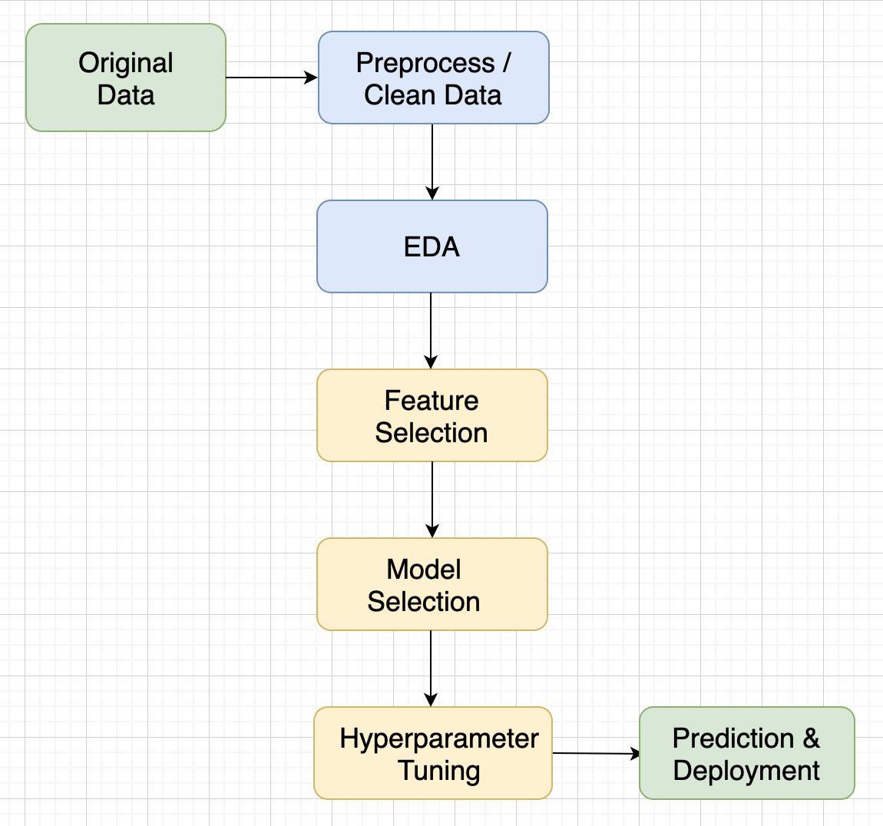
Workflow
No exact recipe, every project is different
Don’t do exploratory analysis just for the sake of it; use it to inform decisions
Model selection through cross-validation on the training set.
Test set untouched until submission
Notes:
Steps in yellow: Iteration

Slide 12

Model selection
Find the best model+hyperparameters through cross-validation on the train set
Report how well your best model does on the test set Fair estimate of how well your selected model would perform on unseen data once deployed

Slide 13
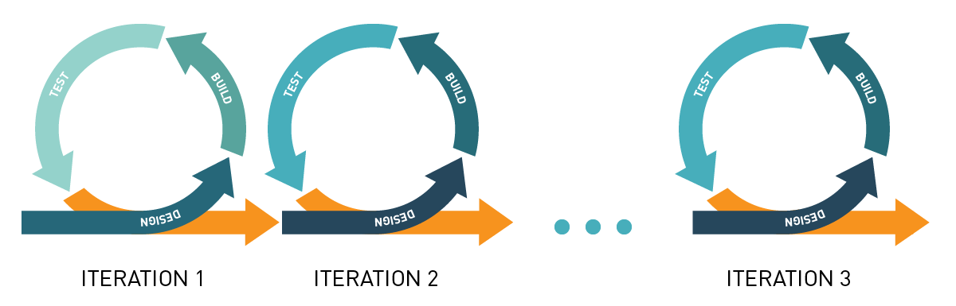
Iterative progress and difficulty
Make a minimum viable product (MVP) early
Dataset difficulty (e.g. one data source before merging many)
Model complexity (e.g. linear regression before xgboost)

Slide 14
How to collaborate
Use GitHub to have one unified remote copy with all past versions
Dropbox etc. will not have a list of past working milestones to roll back to
Dropbox etc. will cause issues if one person is making changes to code that another person is using (due to constant syncing)
Try to parallelize, not pipeline (don’t want anyone to be blocked)
Ideas for parallelizing between team members:
Multiple tables/data sources. Can split EDA of each and come up with interesting insights
Can work on different ML models and/or feature engineering strategies
One works on data/features, other works on modeling/evaluation, but quick MVP!
Meet frequently to discuss insights/next steps and maintain accountability

Slide 15
GitHub essentials

Slide 16
Git steps
1 person creates a repository on GitHub (with README.md)
Clone the repository cd [directory you want to work in] git clone [repository url] cd [repository name]
Make changes (e.g. create jupyter notebooks, add code, etc.) git add [file path] # add any new files to version control git commit -m "[your commit message]" # register changes as a new version
Sync with the remote (cloud) copy. Pull others’ changes, push your own git pull # remote changes -> your copy git push # your copy -> remote (error if there are changes you haven’t pulled)

Slide 17
GitHub conflicts
Git does not constantly sync local+remote automatically like Google Docs. It syncs when you pull/push
What if you and a teammate were modifying the same code?
Example: you both worked on the same function, they pushed first, and you pull
Git will throw an error when you try to pull and will ask you to resolve conflicts
You’ll have to pick which changes to keep: yours, your teammate’s, or a mixture
Can be very difficult to resolve conflicts

Slide 18
GitHub best practices
Commit+push working copies (milestone achieved, no errors)
Add useful commit messages (in case you need to roll back)
Work on separate features/files to avoid conflicts
Git pull frequently to avoid conflicts (local version very out of sync)
If data not too large, add to version control as well
In README, provide all details a new team member would need to navigate and modify the project

Slide 19
Evaluation criteria

Slide 20
Presentation
Present as if to a client (who has some data science knowledge)
Make it a story
What is the problem?
What is the dataset?
How did you analyze the dataset?
What were the findings?
You can walk through code, but only as a chronological reference for explaining how you analyzed the data
However, I recommend having no code at all
5 minutes

Slide 21
Presentation: structure
Motivation: What is the problem? Why is it important (either business, public good, or research perspective)?
Task: Problem from a technical perspective. Description of the dataset, features and targets, data exploration
Modeling: Important aspects of your approach. How did you process the data or engineer features? What model did you use? Use schematics!
Results: Visuals! Show metrics and experiments. Demo (if any)
Conclusions: What worked? What didn’t (and why)? How are we better off? Where could the project go next?

Slide 22
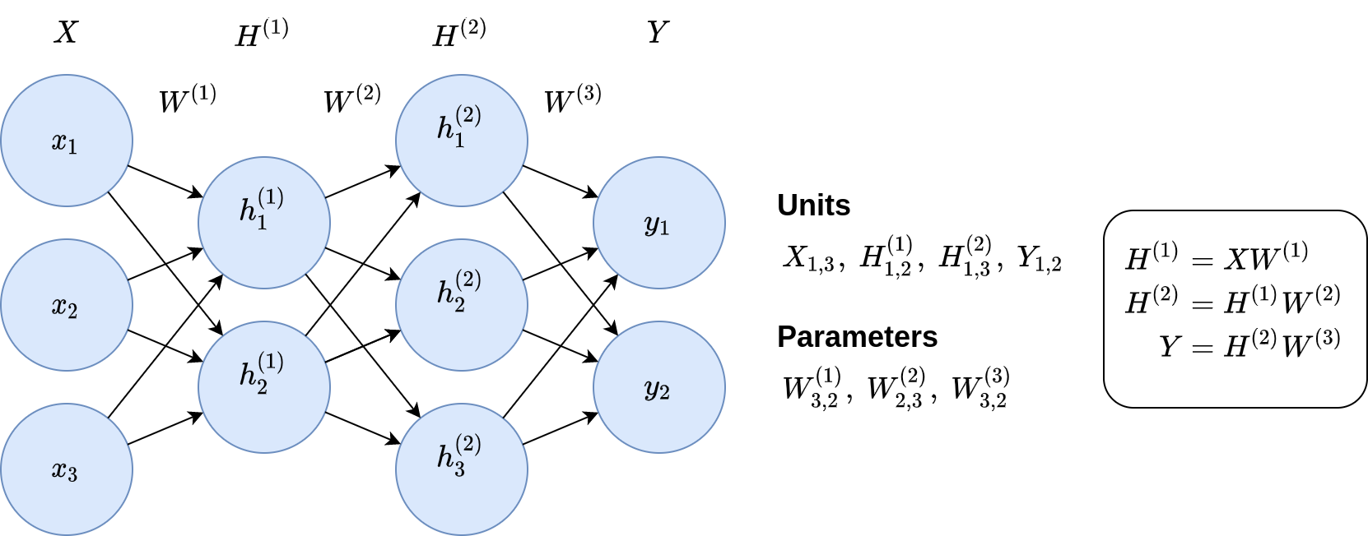
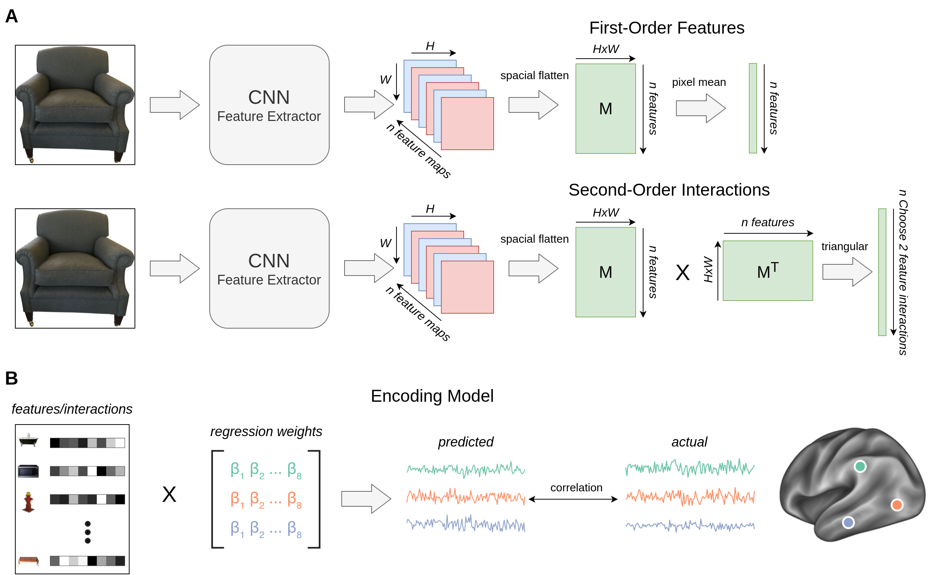
Presentation: draw.io figures
Good for schematics, model diagrams, shapes, math typesetting, etc.

Slide 23
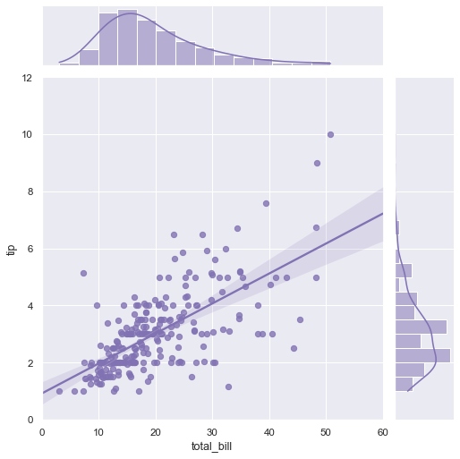
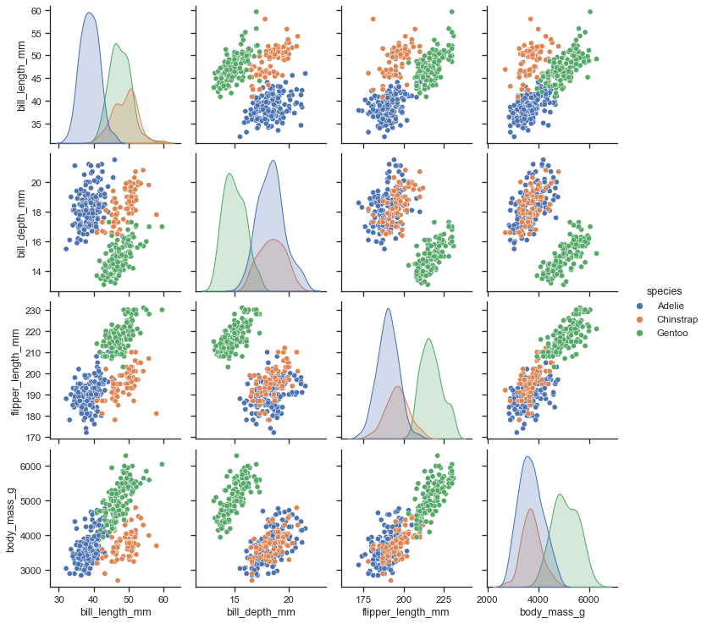
Presentation: python plotting libraries
Good for displaying information about your dataset and results

Slide 24
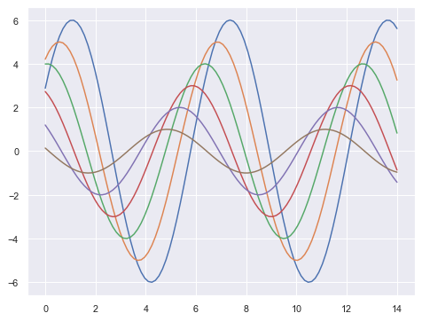
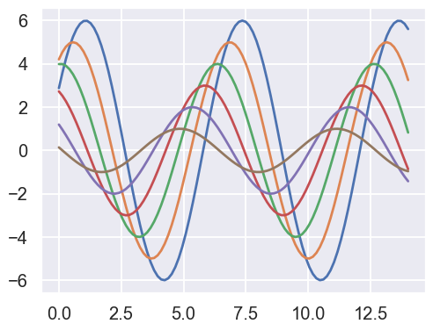
Figures: seaborn
# Right after importing seaborn (could also use 'whitegrid')
sns.set_theme(style='darkgrid', context='talk')
context=’talk’

Slide 25
Code quality
Modularization
Different files for different steps of the ML pipeline (e.g. data processing, model training, etc.)
Functions for unified code (if it has a short english description, it’s probably a function)
Readability
Meaningful variable names
Comments for code blocks, docstrings for functions
Periodically refactor code (e.g. remove old commented out code)
Robustness
Test your functions
Efficiency
Save processed data/trained model, only recreate when needed

Slide 26
Code quality: modularization
repo/
├── data
│ ├── raw_data.csv
│ └── preprocessed_data.csv
├── src
│ ├── modules
│ │ ├── data_preprocessing.py
│ │ └── modeling.py
│ │ └── figure_generation.py
│ ├── tests
│ │ ├── test_data_preprocessing.py
│ │ └── test_modeling.py
│ └── experiments.ipynb
├── output
│ ├── predictions.csv
│ ├── figures
│ │ ├── process_schematic.jpg
│ └── └── cluster_visualizations.jpg
└── README.md
# data_preprocessing.py
...
def load_preprocessed_data():
...
return X, y
...
# experiments.ipynb
from modules.data_preprocessing import load_preprocessed_data
from modules.modeling import train_models
...
X, y = load_preprocessed_data()
best_model, cv_performance = train_models(X, y)
...

Slide 27
Code quality: docstrings
def add_binary(a, b):
'''
Returns the sum of two decimal numbers in binary digits.
Parameters:
a (int): A decimal integer
b (int): Another decimal integer
Returns:
binary_sum (str): Binary string of the sum of a and b
'''
binary_sum = bin(a+b)[2:]
return binary_sum
Other docstring conventions

Slide 28
Code quality: testing
def sum(x, y):
z=x+y
return z
def test_sum():
assert sum(x=3, y=1) == 4

Slide 29
Code quality: avoid retraining model
model = LogisticRegression()
model.fit(X_train, Y_train)
# save the model to disk
filename = 'finalized_model.pkl'
pickle.dump(model, open(filename, 'wb'))
# some time later...
# load the model from disk
file_to_load = 'finalized_model.pkl'
loaded_model = pickle.load(open(file_to_load , 'rb'))
result = loaded_model.score(X_test, Y_test)
print(result)
Pickle tutorial

